Slide 1
SMART PARKING

Slide 2
PROJECT DEFINITION
A smart parking project aims to revolutionize urban parking by utilizing IoT sensors and technology to efficiently manage parking spaces.
It involves deploying sensors in parking areas to detect vehicle occupancy in real-time.
This data is transmitted to a central server for processing and analysis.
Users can access this information through a dedicated mobile app or web interface, allowing them to locate available parking spaces, reserve spots, and make payments seamlessly.
The project enhances the overall parking experience, reduces traffic congestion, and optimizes parking space utilization, contributing to improved urban mobility and sustainability. It also offers valuable data for city planners to enhance urban transportation infrastructure.

Slide 3
DESIGN THINKING
PROJECT OBJECTIVES
IOT SENSOR DESIGN
REAL TIME TRANSIT INFORMATION
INTEGRATION APPROACH

Slide 4
PROJECT OBJECTIVES
REAL TIME PARKING SPACE MONITORING:
The specific objective of real-time parking space monitoring is to develop a system that continuously tracks and provides up-to-the-minute information on available parking spaces within a defined area or facility.
This technology aims to enhance urban mobility and reduce traffic congestion by enabling drivers to quickly locate and reserve parking spots, thereby minimizing the time spent searching for parking.

Slide 5
MOBILE APP INTEGRATION:
Mobile app integration for smart parking refers to the seamless inclusion of a dedicated smartphone application with smart parking systems.
This enables users to access real-time parking information, reserve spots, and make payments conveniently through their mobile devices, enhancing the overall efficiency and user experience of the parking management system.

Slide 6
EFFICIENT PARKING GUIDANCE:
Efficient parking guidance for smart parking involves using technology, such as sensors and real-time data analysis, to direct drivers to available parking spaces swiftly.
It optimizes the utilization of parking facilities, reduces congestion, and enhances the overall parking experience by providing clear, real-time guidance to vacant parking spots.

Slide 7
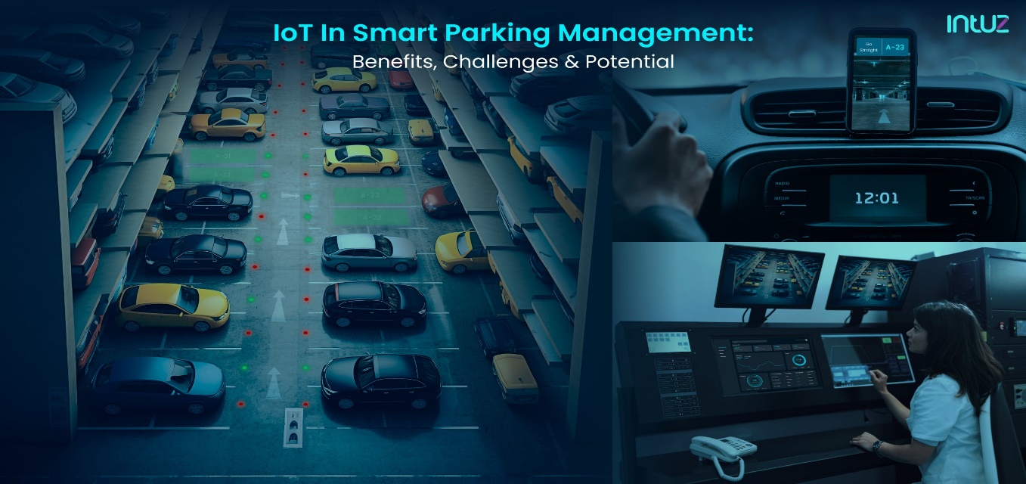
IOT SENSOR DESIGN
Deployment of IoT sensors in parking spaces involves strategically placing sensors that can detect vehicle occupancy.
These sensors transmit data to a central system, enabling real-time monitoring of parking space availability.
This information is then relayed to users, improving parking management and reducing the time spent searching for parking spots.

Slide 8
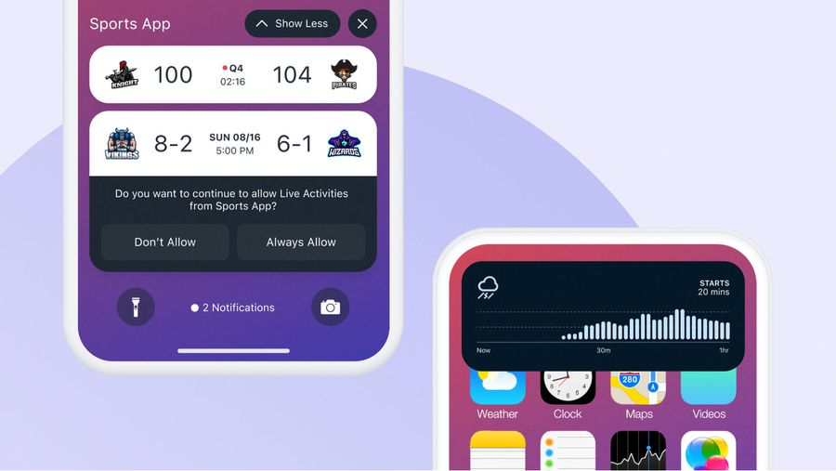
REAL TIME TRANSIT INFORMATION
The mobile app interface offers users real-time parking availability, displaying a map with color-coded icons for vacant (green) and occupied (red) parking spaces.
Users can easily locate and reserve spots, making their parking experience more efficient and convenient, while reducing congestion and search times.

Slide 9
INTEGRATION APPROACH
Raspberry Pi can collect data from sensors by connecting them to its GPIO pins or via USB interfaces. It processes this data and communicates it to a cloud server.
The mobile app accesses the server through APIs, retrieving real-time sensor data, and updates its display accordingly, ensuring users have up-to-date parking information.

Slide 10
These are topics of phase-1: SMART PARKING
By Team mates:
Akash.G
2 . Akash.S
3 . Arun kumar.A
4 . Ashika angel.J
5 . Deepalakshmi.E

